Slide 1
How to check a simulation study
Tra My Pham | MRC Clinical Trials Unit at UCL
Co-authors: Ian White, Matteo Quartagno, Tim Morris
08/09/2023 | 2023 UK Stata Conference

Slide 2
Motivation
We use simulation studies to assess e.g. statistical methods or power of a study
Sometimes they can go wrong
How do we check them?
Can we make them less likely to go wrong?
This work draws on our experience of checking simulation studies
Considerations discussed in Morris, White & Crowther (2019) and more recently in White et al 2023 (accepted by IJE and preprint)
Morris TP, White IR, Crowther MJ. Using simulation studies to evaluate statistical methods. Stat Med 2019; 38: 2074–2102
White IR, Pham TM, Quartagno M, Morris TP. How to check a simulation study. OSF 2023; https://doi.org/10.31219/osf.io/cbr72

Slide 3
Simple simulation study: ADEMPI

Slide 4
Simple simulation study: ADEMPI
Aim | To compare multiple imputation with complete case analysis

Slide 5
Simple simulation study: ADEMPI
Aim | To compare multiple imputation with complete case analysis
Data generating methods
N(0,1); initially MCAR
C
Logistic regression | C
Logistic regression | C
E
D
Varied parameters: Pr(E) & Pr(D), the strength of the dependence of E and D on C, missingness mechanism
Fixed: nsample = 500

Slide 6
Simple simulation study: ADEMPI
Estimand | Log odds ratio between E and D, conditional on C

Slide 7
Simple simulation study: ADEMPI
Estimand | Log odds ratio between E and D, conditional on C
Methods of analysis | Logistic regression of D on E and C, using Full data before setting some values of C to missing Complete case analysis (excluding cases with missing C) Multiple imputation of missing values of C (Missing values replaced with several plausible values based on observed data)

Slide 8
Simple simulation study: ADEMPI
Estimand | Log odds ratio between E and D, conditional on C
Methods of analysis | Logistic regression of D on E and C, using Full data before setting some values of C to missing Complete case analysis (excluding cases with missing C) Multiple imputation of missing values of C (Missing values replaced with several plausible values based on observed data)
Performance measures | Bias, empirical & model-based standard error, coverage

Slide 9
Simple simulation study: ADEMPI
Estimand | Log odds ratio between E and D, conditional on C
Methods of analysis | Logistic regression of D on E and C, using Full data before setting some values of C to missing Complete case analysis (excluding cases with missing C) Multiple imputation of missing values of C (Missing values replaced with several plausible values based on observed data)
Performance measures | Bias, empirical & model-based standard error, coverage
Implementation | nsim = 1000 repetitions

Slide 10
How to check a simulation study
16 points of advice
Arranged by Design, Conduct, Analysis
Illustrated by simple simulation study
Stata code available at https://osf.io/egc73/

Slide 11
Design: planning the simulation
1. Include a setting with known properties (benchmark)

Slide 12
Example simulation study
Data generating methods
N(0,1); initially MCAR
C
Logistic regression | C
E
D
Logistic regression | C
Complete case analysis unbiased under Missing Completely At Random

Slide 13
Example simulation study
Methods of analysis | Logistic regression of D on E and C, using Full data before setting some values of C to missing Complete case analysis (excluding cases with missing C) Multiple imputation of missing values of C (Missing values are imputed with several plausible values based on observed data)
Unbiased & most precise
Least precise

Slide 14
Conduct: coding the simulation
2. Write well-structured code

Slide 15
prog define gendata
syntax, obs(int) logite(string) logitd(string) pmiss(string)
[generate Ctrue (full data), E, D, Cobs (MCAR)]
end
prog define anadata
//Method 1: full data before data deletion
logit D E Ctrue
[save results]
//Method 2: CCA
logit D E Cobs
[save results]
//Method 3: MI
mi impute regress Cobs D##E, add(5)
mi estimate: logit D E Cobs
[save results]
end
3 main tasks
Generate data
Analyse data
Save results in well-structured estimates dataset
2 separate programs
gendata data generation
anadata data analysis & results extraction
Results stored in estimates dataset via postfile

Slide 16
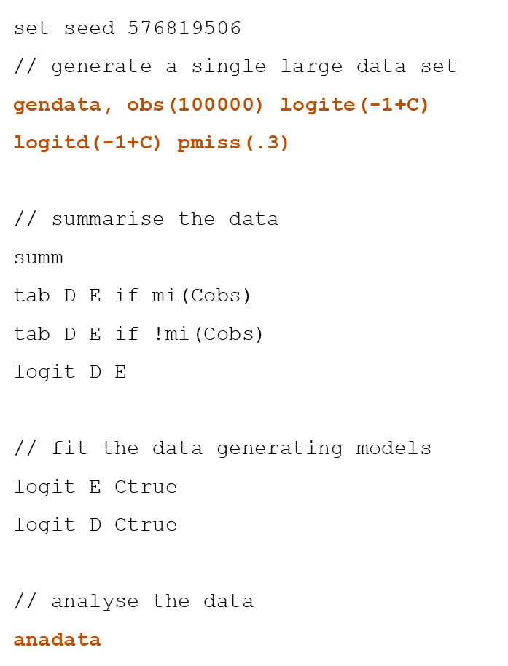
Conduct: coding the simulation
3. Study a single very large dataset
Use gendata to generate a single very large dataset
Check anadata runs successfully on this dataset

Slide 17
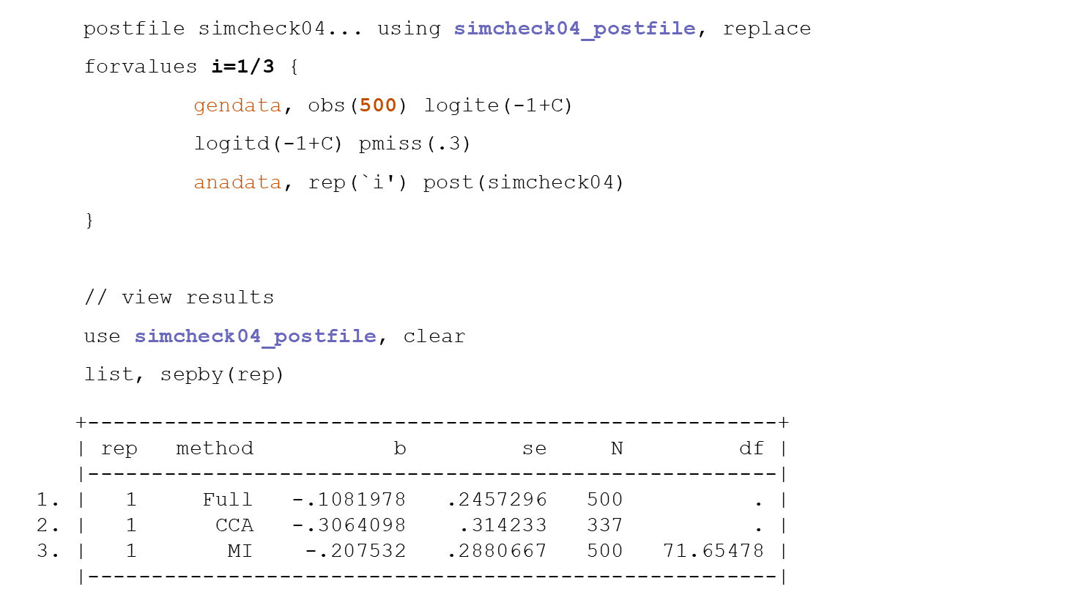
Conduct: coding the simulation
3. Study a single very large dataset
Use gendata to generate a single very large dataset (e.g. with nsample=100000)
Check anadata runs successfully on this dataset
4. Run the simulation with a small number of repetitions
Run 3 repetitions using gendata & anadata; check they all give different results
Check results stored match those displayed on screen

Slide 18
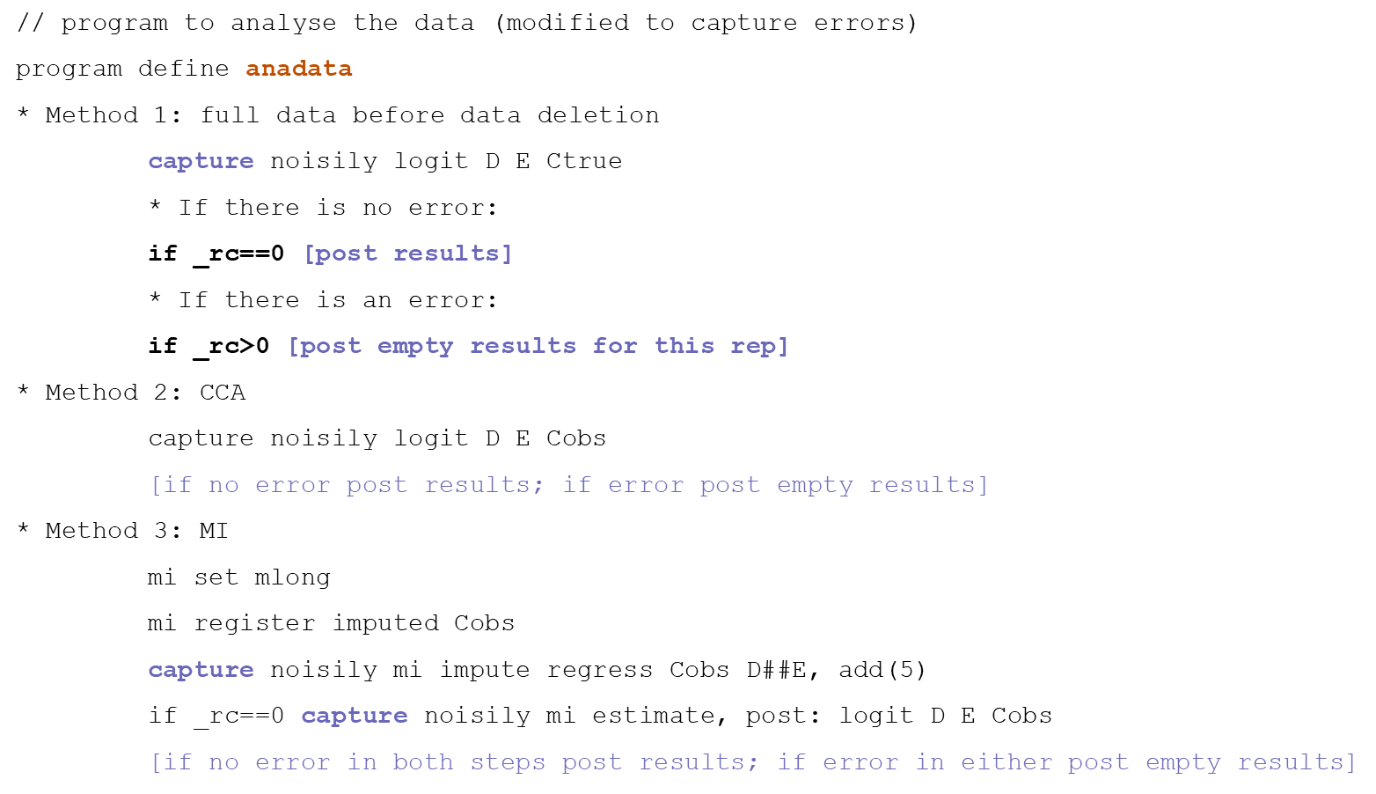
Conduct: coding the simulation
3. Study a single very large dataset
Use gendata to generate a single very large dataset (e.g. with nsample=100000)
Check anadata runs successfully on this dataset
4. Run the simulation with a small number of repetitions
Run 3 repetitions using gendata & anadata; check they all give different results
Check results stored match those displayed on screen
5. Anticipate analysis failures
Use capture in anadata to post empty results for repetitions with failures

Slide 19
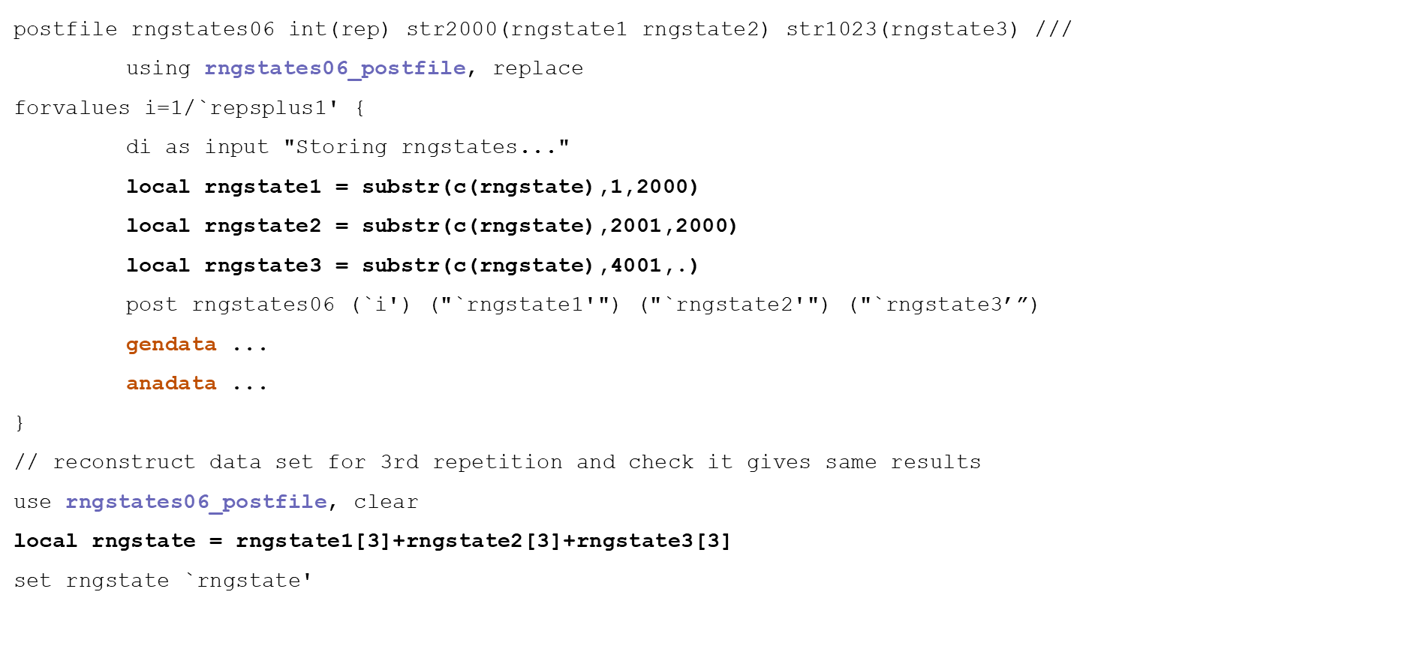
Conduct: coding the simulation
3. Study a single very large dataset
Use gendata to generate a single very large dataset (e.g. with nsample=100000)
Check anadata runs successfully on this dataset
4. Run the simulation with a small number of repetitions
Run 3 repetitions using gendata & anadata; check they all give different results
Check results stored match those displayed on screen
5. Anticipate analysis failures
Use capture in anadata to post empty results for repetitions with failures
6. Make it easy to re-create any simulated dataset
Use postfile to save c(rngstate)at start of each repetition

Slide 20
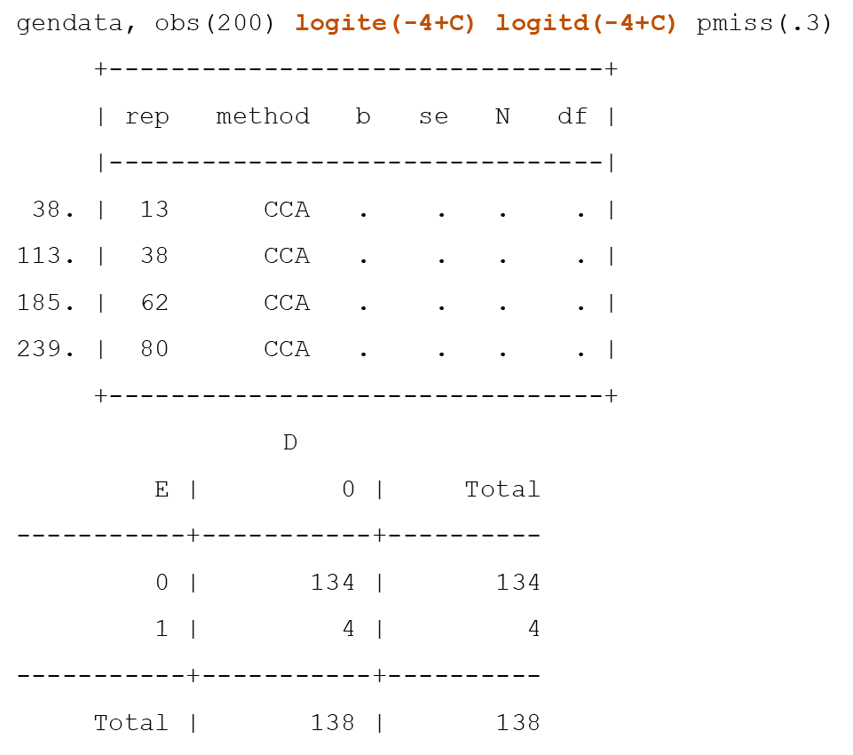
Analysis: method failures and outliers
7. Count and understand method failures
Count method failures, by method & data generating mechanism
CCA occasionally failed under more extreme DGM
Repetition 13

Slide 21
Analysis: method failures and outliers
7. Count and understand method failures
Count method failures, by method & data generating mechanism (e.g. summ / tab)
8. Look for outliers
Plot the standard error estimates against the point estimates
gendata with more extreme DGM

Slide 22
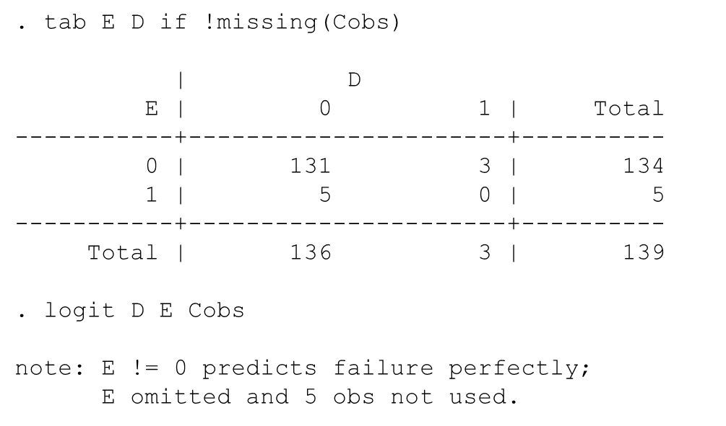
Analysis: method failures and outliers
7. Count and understand method failures
Count method failures, by method & data generating mechanism (e.g. summ / tab)
8. Look for outliers
Plot the standard error estimates against the point estimates
9. Understand outliers
Re-create and explore a simulated dataset which gave outlying results
gendata with more extreme DGM
Repetition 1

Slide 23
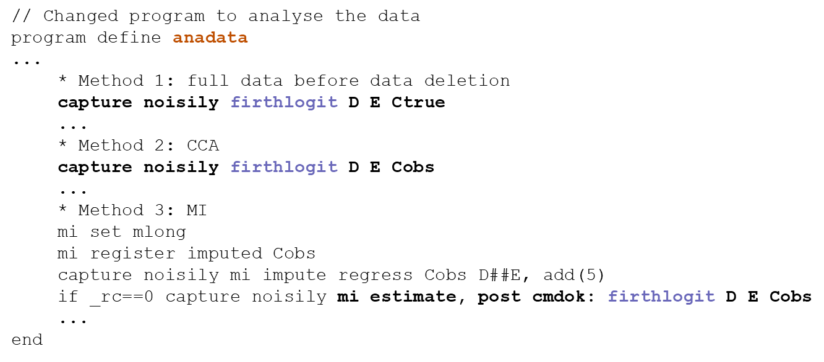
Analysis: method failures and outliers
7. Count and understand method failures
Count method failures, by method & data generating mechanism (e.g. summ / tab)
8. Look for outliers
Plot the standard error estimates against the point estimates
9. Understand outliers
Re-create and explore a simulated dataset which gave outlying results
10. Deal with outliers
Exclude from results? (selection bias)
Program a back-up analysis method?
Change the simulation design?
Penalised logistic regression as alternative

Slide 24
Analysis: unexpected findings
11. Check Monte Carlo errors | Is it really a bias / under-coverage, or is it noise?

Slide 25
Analysis: unexpected findings
11. Check Monte Carlo errors | Is it really a bias / under-coverage, or is it noise?
12. Why are model-based standard errors wrong? | e.g. sources of variation in the DGM and analysis don’t correspond

Slide 26
Analysis: unexpected findings
11. Check Monte Carlo errors | Is it really a bias / under-coverage, or is it noise?
12. Why are model-based standard errors wrong? | e.g. sources of variation in the DGM and analysis don’t correspond
13. Why is coverage poor? | Is it driven by bias, wrong intervals, or both? (zip plot, produced by Stata package siman)
https://github.com/UCL/siman

Slide 27
Analysis: unexpected findings
11. Check Monte Carlo errors | Is it really a bias / under-coverage, or is it noise?
12. Why are model-based standard errors wrong? | e.g. sources of variation in the DGM and analysis don’t correspond
13. Why is coverage poor? | Is it driven by bias, wrong intervals, or both? (zip plot, produced by Stata package siman)
14. Why are power and type I error wrong? | e.g. interchanging power and type I error
https://github.com/UCL/siman

Slide 28
Analysis: unexpected findings
11. Check Monte Carlo errors | Is it really a bias / under-coverage, or is it noise?
12. Why are model-based standard errors wrong? | e.g. sources of variation in the DGM and analysis don’t correspond
13. Why is coverage poor? | Is it driven by bias, wrong intervals, or both? (zip plot, produced by Stata package siman)
14. Why are power and type I error wrong? | e.g. interchanging power and type I error
15. When do unexpected findings occur? | e.g. they occur only when the DGM includes a particular source of variation while analyses aren’t allowing for this source of variation?
https://github.com/UCL/siman

Slide 29
Analysis: unexpected findings
11. Check Monte Carlo errors | Is it really a bias / under-coverage, or is it noise?
12. Why are model-based standard errors wrong? | e.g. sources of variation in the DGM and analysis don’t correspond
13. Why is coverage poor? | Is it driven by bias, wrong intervals, or both? (zip plot, produced by Stata package siman)
14. Why are power and type I error wrong? | e.g. interchanging power and type I error
15. When do unexpected findings occur? | e.g. they occur only when the DGM includes a particular source of variation while analyses aren’t allowing for this source of variation?
16. General checking method | Re-code the simulation study in a different statistical package? Have a different person code it?
https://github.com/UCL/siman

Slide 30
Conclusion
Simulation studies should be designed that can be easy to check
They should be checked repeatedly during the conduct and analysis stages
This list is not exhaustive, suggestions are welcome!

Slide 31

Acknowledgements
Study with us online for an MSc Clinical Trials or an MSc Statistics in Clinical Trials.
Find out more: https://bit.ly/3EwrvJK
This work was supported by the Medical Research Council [grant number MC_UU_00004/07]

